Slide 1

Online Movie Booking System: Team Introduction
Presented by :
Under the guidance of: Suramya Biswas
Nivedha S
Rasika H
Tumati Sasi Rekha
Abishek R
Santhosh M
Tushar R Shekokar

Slide 2

Online Movie Booking System
The Online Movie Booking System is a comprehensive platform that allows users to easily search, select, and purchase movie tickets from the comfort of their own devices. With a user-friendly interface and seamless transaction process, this system aims to revolutionize the movie-going experience.

Slide 3





Technologies & Tools: Our Toolkit
Back-end
1
Java Spring Boot 3 .0,Spring Data JPA,Spring Security
Front-end
2
CSS,JavaScript and JSP
Database
3
MySQL 8.0
Build Tool and Code Editor
4
Maven and Eclipse IDE
Server
5
Apache Tomcat 9.0

Slide 4
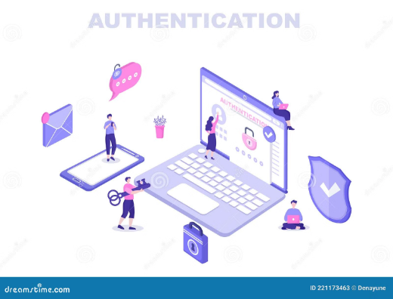
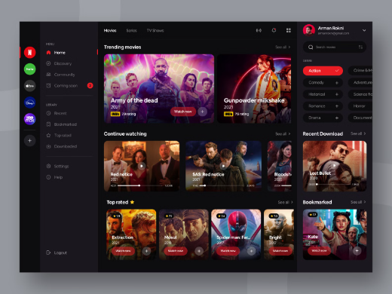
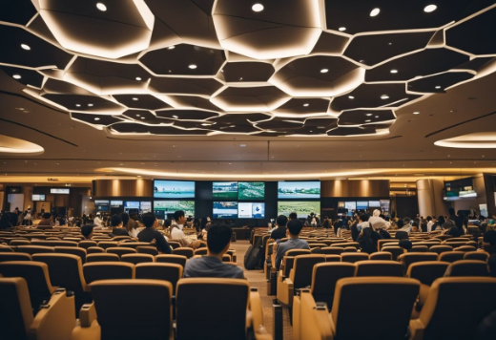
MODULES TO BE IMPLEMENTED
Showtime Management
User Authentication & Authorization
Movie Management
Enables scheduling and managing movie screenings, including times and seating arrangements.
Securely verifies user identity and controls access to features.
Provides a comprehensive platform for adding, updating, and managing movie information.

Slide 5
Booking Management: A Smooth Transaction
1
2
3
Booking Details
Payment Processing
Booking Confirmation
Includes movie selection, showtime, seating, and user information.
Offers secure and convenient payment options for a seamless experience.
Generates a confirmation email and provides detailed booking information.

Slide 6
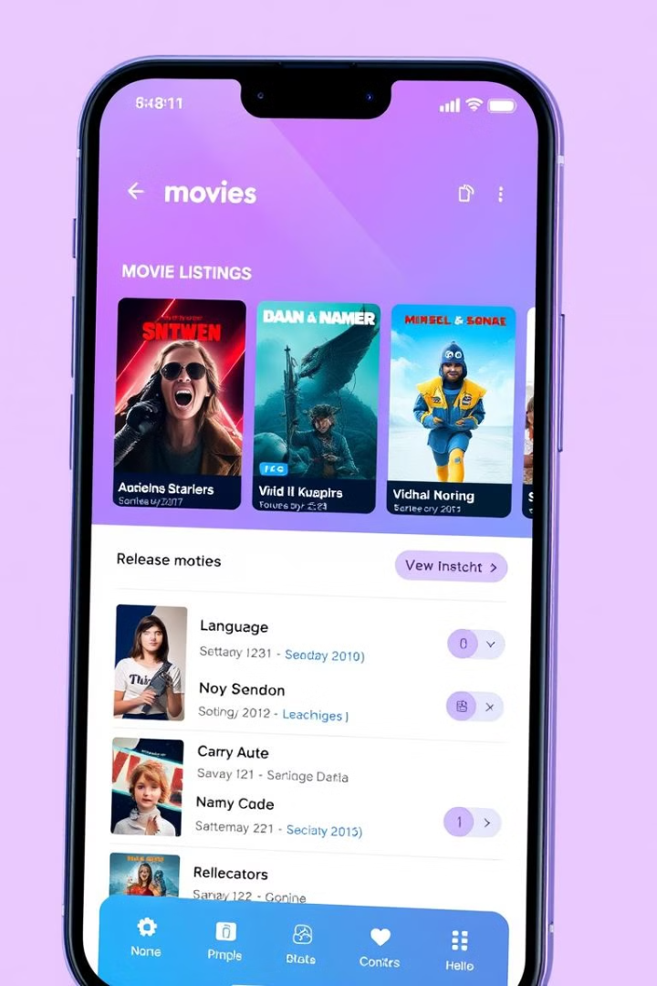


Integration & Advanced Features
Integrated Systems
Movie Search by Language
Integrates with external movie databases and payment gateways for a comprehensive solution.
Allows users to easily find movies based on their preferred language.

Slide 7

Project Goals: Delivering Excellence
1
User Experience
2
Security
Provide a smooth and intuitive experience for booking movies.
Implement robust security measures to protect user data and transactions.
3
Data Management
Ensure the efficient and reliable storage and retrieval of movie and booking data.

Slide 8
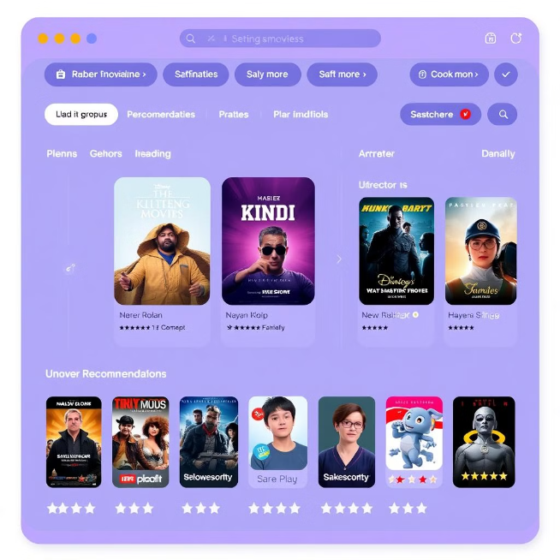
Future Enhancements for Users
The online movie booking system can be improved to offer users a more personalized experience.
This involves providing tailored recommendations based on user preferences and past booking history.
Recommendation algorithms can suggest movies based on genre, actors, directors, and other factors.
User reviews and ratings can be leveraged to provide insights into popular movies.
Suggest movies based on user preferences and history and providing tailored engagement.

Slide 9
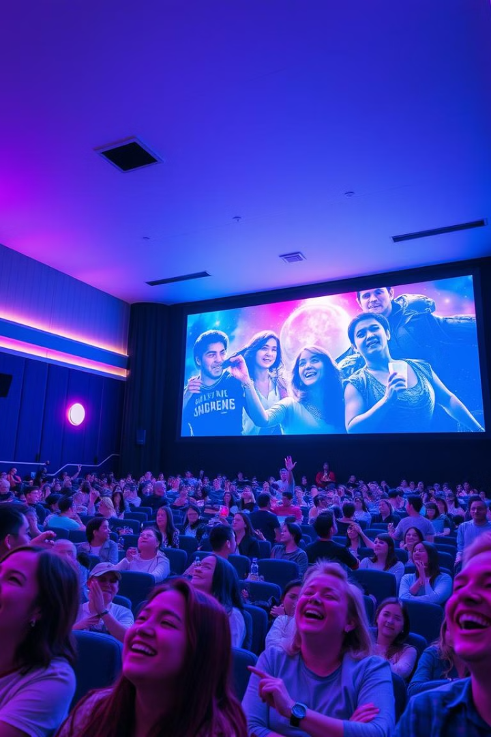
Conclusion: A Vision Realized
This project represents a significant step in revolutionizing the movie booking experience. We are confident that our system will provide a user-friendly, secure, and efficient platform for booking tickets.

Slide 10
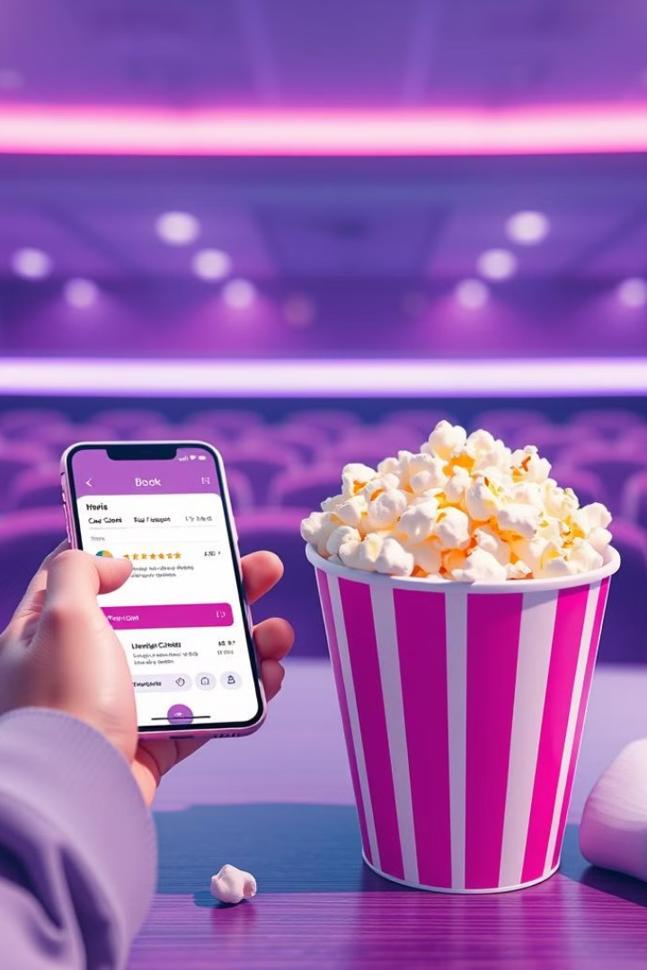
Thank You for your time and support!
"Thank you for empowering us to bring convenience and excitement to the movie going journey! "

